Slide 1


Introduction to Crime
Crime is a complex and multifaceted issue that affects societies worldwide. This presentation will provide an overview of the different types of crimes, their causes, and the criminal justice system's role in addressing them.

Slide 2
Types of Crimes
1
White-Collar Crime
2
Corporate Crime
3
Organized Crime
Nonviolent crimes committed by individuals in the course of their employment, such as fraud, bribery, and money laundering.
Illegal activities committed by corporations, such as environmental violations, price-fixing, and tax evasion.
Criminal activities carried out by coordinated groups, such as drug trafficking, human trafficking

Slide 3
Types of Crimes
4
Crimes against the
person
5
Crimes against
property
6
Victimless crimes
Crimes
that direct violence or
the threat of violence
against others; also
known as violent crimes
Crimes that involve theft
of property belonging to
others; also known as
property crimes
Violations of law in
which there are no
obvious victims

Slide 4
Causes of Crime
Poverty and Inequality
Substance Abuse
Lack of economic opportunities and social support can drive individuals to engage in criminal activities.
Addiction to drugs and alcohol can lead to criminal behavior, such as theft and drug-related crimes.
Mental Illness
Lack of Education
Untreated mental health issues can contribute to criminal behavior, such as violence and impulsive acts.
Inadequate access to education and resources can limit opportunities and increase the risk of criminal involvement.

Slide 5
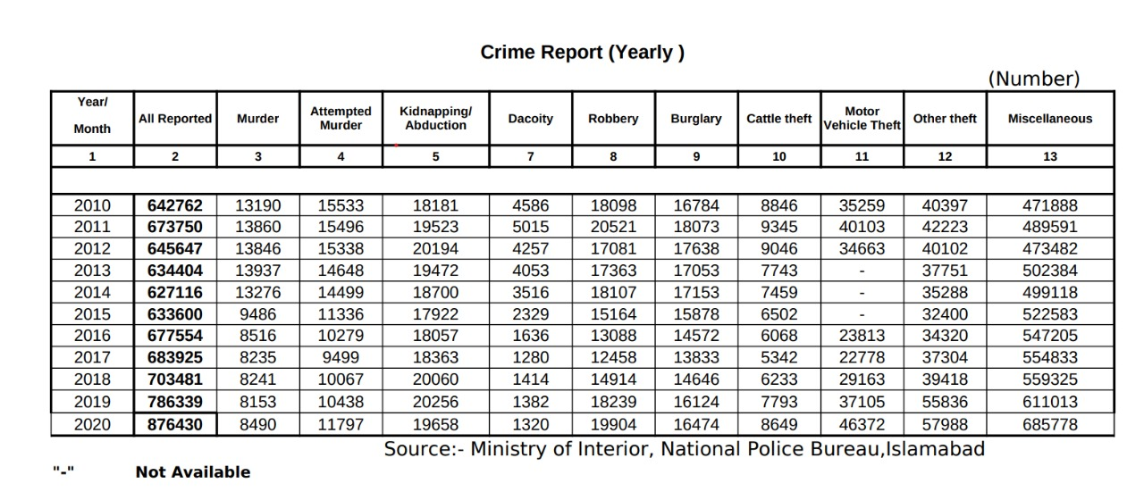
Crime Statistics

Slide 6
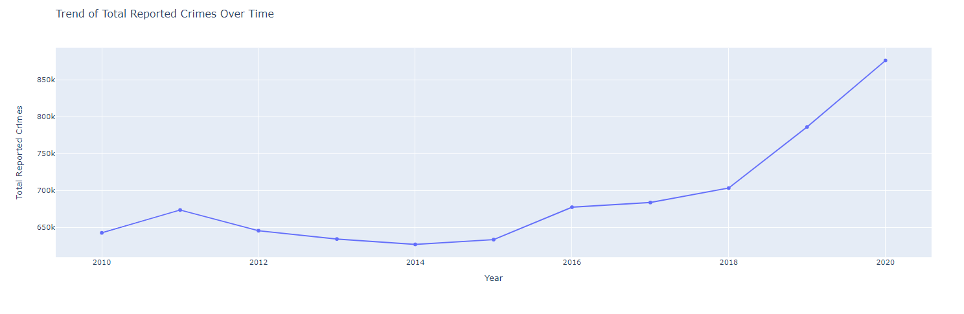
Crime Statistics

Slide 7
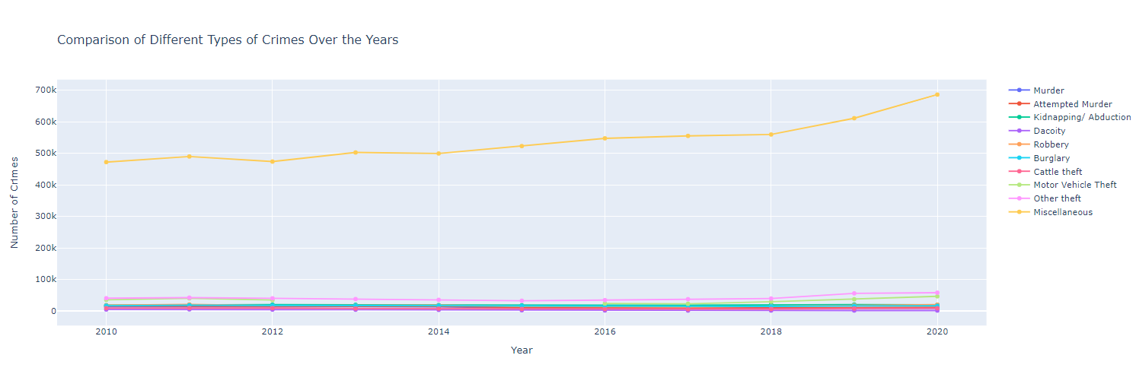
Crime Statistics

Slide 8




Law Enforcement and the Criminal Justice System
Law Enforcement
Courts
Corrections
Legislation
Police and other law enforcement agencies are responsible for investigating crimes and apprehending suspects.
The judicial system, including courts and judges, is responsible for adjudicating cases and determining guilt or innocence.
Prisons, jails, and other correctional facilities are responsible for housing and rehabilitating offenders.
Lawmakers and policymakers are responsible for creating and enforcing laws that govern criminal behavior.

Slide 9




Crime Prevention Strategies
Community-Based Approaches
Situational Crime Prevention
Rehabilitation and Reintegration
Engaging with local communities to address the root causes of crime and promote social cohesion.
Designing environments and implementing measures to make it more difficult for individuals to commit crimes.
Providing offenders with access to education, job training, and mental health services to reduce recidivism.

Slide 10
Key Takeaways
Crime is a complex issue with diverse types and causes
The criminal justice system plays a crucial role in addressing crime
Effective crime prevention strategies require a multifaceted approach

Slide 11
Conclusion
Addressing crime requires a comprehensive understanding of its underlying factors and a coordinated effort among various stakeholders, including law enforcement, policymakers, and community members.

Slide 12
References
https://en.wikipedia.org/wiki/Crime
https://punjabpolice.gov.pk/crimestatistics
https://www.npb.gov.pk/publications

Slide 13
Thank you

